Slide 1
SMART BILLBOARDS USING IBM WATSON
BY
- K.VENKATESH
- CH.POOJA

Slide 2
Contents:
Billboard
Description
Hardware components
1. NODEMCU
2.Basic board
a)Light Emitting Diode
b)Switch
3.OLED Display
4.IBM cloud and NodeREd
Block diagram
Advantages
Conclusion

Slide 3
BILLBOARD:
Billboard is a large outdoor advertising structure typically found in high traffic area and busy roads.
Billboards typically shows large witty slogans and distinctive visuals.
Billboards are generally placed on highways, expressways where they command high density consumer exposure.
Poster is also a form of billboard advertising, viewed principally by residents and commuter traffic, with some pedestrian exposure.

Slide 4
Description:
The use of Smart boards has widely increased these days. The applications that can be developed using these smart boards have been increasing day-by-day.
Smart billboards can also target motorists on the highway or pedestrians passing bus shelters.
Companies can attract the customers by doing advertisements. These smart bill boards will help them in attracting their customers and make their task easier.
In this we can upload the required data on the bill board simply by giving inputs through user interface. And we can check the lamps working status which is connected to bill board through the UI.
Through device we can select the mode of the display and according to the selected mode we can change the data on the display. the data can be entered through user interface which is created in Node Red. We can get the status of the lamps which are connected to the bill boards in the user interface. If any lamp fails we can send notifications to authorities.

Slide 5
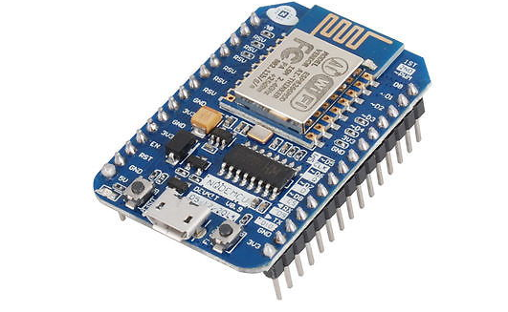
Hardware components:
1.NODEMCU:
NODEMCU is an open source LUA based firmware developed for ESP8266 WIFI chip. By exploring functionality with ESP8266 chip, NODEMCU firmware comes with ESP8266 Development board/kit i.e. NODEMCU Development board.
Since NODEMCU is open source platform, their hardware design is open for edit/modify/build.
NODEMCU Dev Kit/board consist of ESP8266 WIFI enabled chip. The ESP8266 is a low-cost WIFI chip developed by ESPRESSIF Systems with TCP/IP protocol.
NODEMCU Dev Kit has Arduino like Analog (i.e. A0) and Digital (D0-D8) pins on its board.
It supports serial communication protocols i.e. UART, SPI, I2C etc.

Slide 6
2.Basic board
a)Light Emitting Diode:
A light-emitting diode (LED) is semiconductor lightsource that emits light when current flows through it.
Electrons in the semiconductor recombine with electron holes, releasing energy in the form of photons. This effect iscalled electroluminescence.
The color of the light (corresponding to the energy of the photons) is determined by the energy required for electrons to cross the band gap of the semiconductor. White light is obtained by using multiple semiconductors or a layer of light-emitting phosphor on the semiconductor device.
Light-emitting diodes are used in applications as diverse aviation lighting, automative lightings advertising, traffic signals, camera flashes, lighted wallpaper and medical devices.

Slide 7
b)Switch:
A switch is an electrical component that can "make" or "break" an electrical circuit, interrupting the current or diverting it from one conductor to another.
The mechanism of a switch removes or restores the conducting path in a circuit when it is operated. It may be operated manually, for example, a light switch or a keyboard button, may be operated by a moving object such as a door, or may be operated by some sensing element for pressure, temperature or flow.
A common use of switch is control of lighting, where multiple switches may be wired into one circuit to allow convenient control of light fixtures.
In this project we used switch as to ON/OFF the light. When switch is on the light will be ON and vice versa.

Slide 8

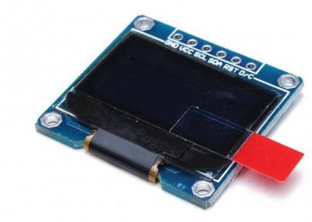
3.OLED Display:
An organic light-emitting diode (OLED) is a LED in which the emissive electroluminescent layer is a film of organic compound that emits light in response to an electric current.
Organic layer is situated between two electrodes; typically, at least one of these electrodes is transparent. OLEDs are used to create digital displays in devices such as television screens, computer monitors, portable systems such as smartphones and PDAs.
A major area of research is the development of white OLED devices for use in solid state lighting applications

Slide 9
4.IBM cloud and NodeRed:
IBM Cloud is a suite of cloud computing services from IBM that offers both platform as a service (PaaS) and infrastructure as a service (IaaS). With IBM Cloud IaaS, organizations can deploy and access virtualized IT resources -- such as compute power, storage and networking -- over the internet.
Node-RED is a programming tool for wiring together hardware devices, APIs and online services in new and interesting ways. It provides a browser-based editor that makes it easy to wire together flows using the wide range of nodes in the palette that can be deployed to its runtime in a single-click.
The network is responsible for the flow of data between the nodes. Node-RED is based on flow-based programming which describes an application's behavior as a network of black-boxes (nodes). ... This not only saves time but is a major help when designing or troubleshooting IoT and Industrial IoTApplications.

Slide 10
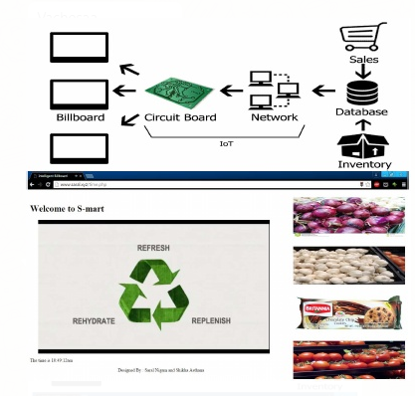
Block diagram:

Slide 11
Advantages:
The purpose of billboards is to create awareness. They are effectively used to broadcast the services of your business.
Billboards are a great way to reach the masses – to reach where they live, commute, work and socialize.
The purpose of a billboard is to interrupt as many people as possible, to create awareness not necessarily impact, to broadcast instead of engage
advertising, it can't be put down.

Slide 12
Thank you

